Slide 1
STUDENT Management system
SUBMITTED BY
KAVYA P

Slide 2
OBJECTIVE
Student Management System is a solution tool that is designed to track, maintain and manage all the data generated by a School, including the grades of a student, their attendance, their interpersonal activities records, etc.
Student Management System acts as the bottom line database to store all the day-to-day school operations, maintain the proper records of the past few decades, regulate the various operation modules, managing the critical tasks, efficiently handling the administrative processes.

Slide 3
SCOPE
This system is aimed at total user-friendly as well as efficient management of varied tasks.
These tasks may range from registering new students, managing fees payment, examination management to all the essential features necessary for making the administrative division of school effective.

Slide 4
REQUIREMENTS
Operating System: Windows 10.
Tools: Spring Tool Suite - To develop the project,
My SQL – For the database.
Front End: JSP, HTML,
Programming Language: JAVA.
Back End: My SQL.

Slide 5
FUNCTONAL REQUIRMENTS
enquiries and admissions, enrolment and fees, assessment and progression, completion and graduation, regulatory and organizational reporting and curriculum management

Slide 6
Output for login

Slide 7
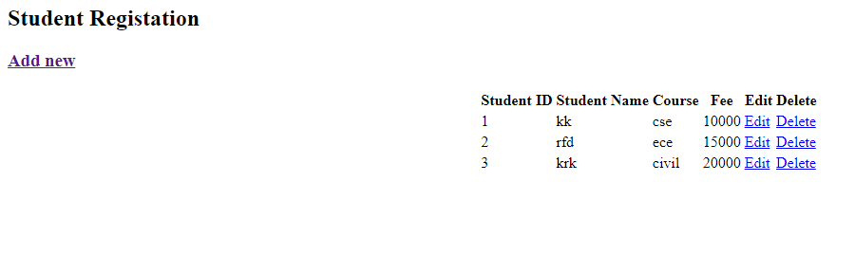
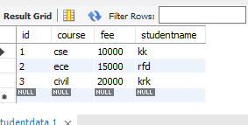
Output for Add new details

